Slide 1
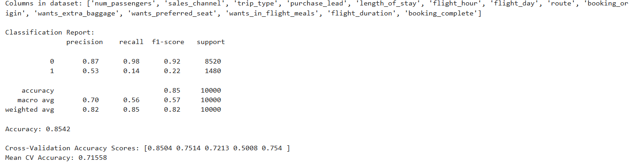
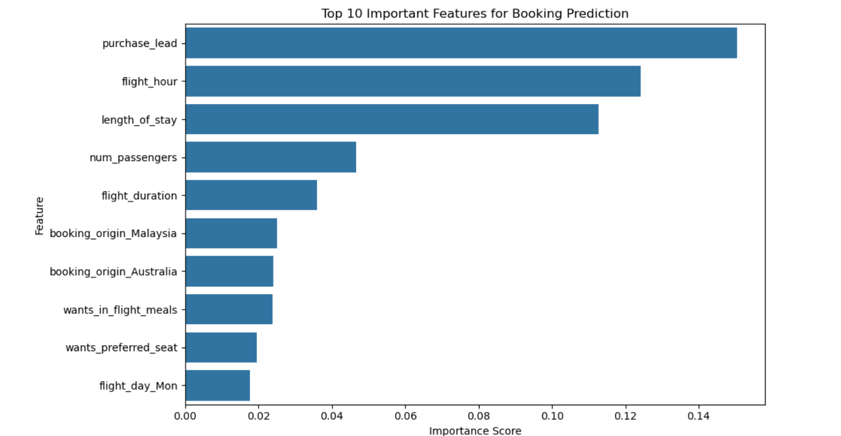

Slide 2
“Why are you interested in this role?”
I recently participated in the British Airways job simulation on the Forage
platform, and it was incredibly useful to understand what it might be like to
participate on a Data Science team at British Airways.
I worked on a project where I analysed customer insights and built a predictive
model to understand factors that influence buying behaviour. I practised my data
analytics skills using a Jupyter Notebook and built my PowerPoint and
communication skills by presenting insights in a real-world context.
Doing this programme confirmed that I really enjoy working with data to provide
business insights, and I'm excited to apply these skills to a Data Science team
at a company like British Airways.

